Slide 1
Rhomboidity of Billet Casting
Presented By: Rohan J.
Last Updated: June 8th,2021

Slide 2
Table of Content
Rhomboidity of Casting
Purpose Statement(What we are talking about).
Case study.
Conclusion.

Slide 3
What are we talking about?

Slide 4
Objective
Identify if there are any structural, chemical, and/or mechanical properties that contribute to rhomboidity of casting.

Slide 5
Rhomboidity
The billet emerges from the bottom of the mold, essentially a square, but the uneven internal cooling mechanism forces a rhomboid shape just below the mold. Rhomboidity at or over a certain percentage leads to billet twisting in the roughing stands of the rolling mill.

Slide 6
Determination
Rhomboidity is determined by the difference n=between the two diagonals (d₁ & d₂), expressed in mm or percentage.
Rhomboidity (%) = ((d₂ - d₁)/((d₂ + d₁)/2)) x 100

Slide 7
Case study.

Slide 8
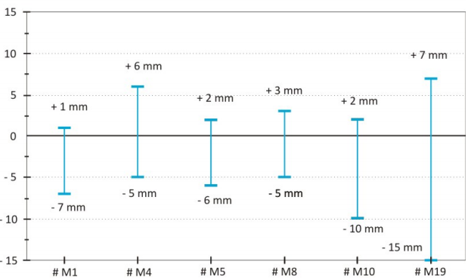
Structural properties(size)
Rhomboidity vary widely with size of billets.
Little correlation between size of billets and rhomboidity.
Size is not a strong indicator of rhomboidity.

Slide 9
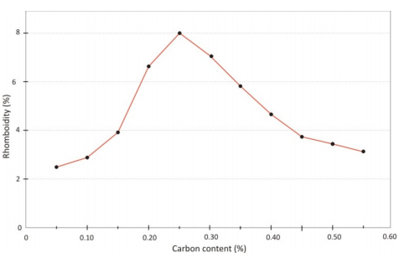
Chemical properties(carbon content)
Carbon content has some correlation with rhomboidity.
Medium carbon steels are more sensitive to off-squareness than low carbon or high carbon steels.
Carbon content is a strong indicator of rhomboidity.

Slide 10
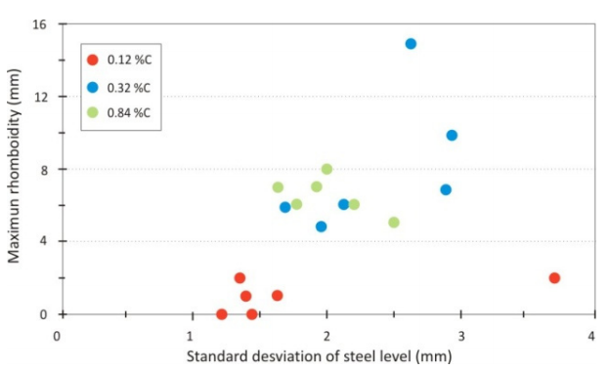
Carbon content of steel
Medium carbon steel has a particular solidification path, starting with δ ferrite up to arriving to the peritectic temperature, where the already solidified δ ferrite, together with liquid in the peritectic proportion, transforms into austenite.
Then, remaining liquid solidifies gradually into austenite with cooling. In these steels, as a difference with the so called peritectic steels (carbon 0.10 to 0.18%), δ ferrite and austenite do not coexist below the peritectic temperature, and some liquid still remains below that temperature.
Medium carbon steel pass only through the first stage of peritectic reaction, but it does not suffer the second stage.

Slide 11
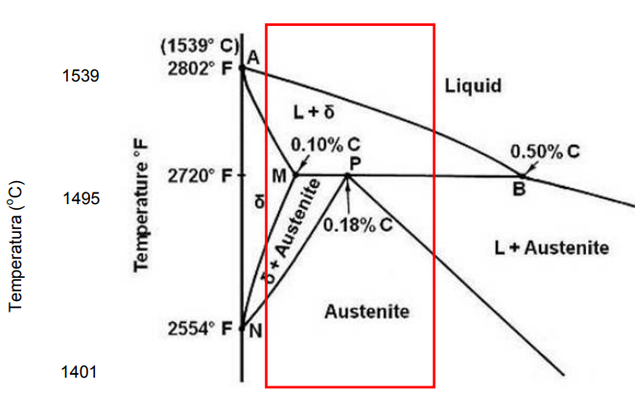
Carbon content of steel
Proclivity of these steels to rhomboidity has been attributed to the fact that, in comparison with lower carbon steels, that display low heat transfer in the mold, they have usually higher heat transfer.In comparison, for high carbon steels the solidification range is narrower.
For instance, if mold heat transfer decreases 25% in a given location, and increases 25% in another location, the difference in shell thickness 25 mm below meniscus is 1 mm for a 0.32% C steel; 0.4 mm for 0.84% C steel and just 0.2 mm for a 0.12% C steel. So, the impact of uneven cooling in generating non uniform shell is larger for medium carbon steel.
For this steel, heat extraction in mold is important (4500 kW/m² ) and at the same time the solidification range is narrow (50º C). This combination is different for low carbon steel (low mold heat transfer, 2500 kW/m² ) and for high carbon steel (wide solidification range, 100ºC). High alloyed steels are susceptible to offsquareness, too.

Slide 12
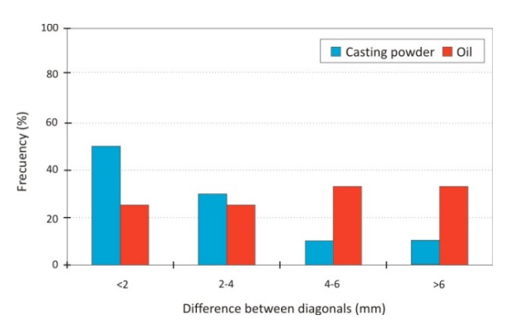
Mechanical properties(formation mechanism)
Formation mechanism or molding has a huge impact on rhomboidity.
Formation mechanism is a strong indicator of rhomboidity.

Slide 13
Formation mechanism(molding)
The mold shape could distort into a rhomboid, thus giving place to a rhomboidal strand.
Another mechanism, the formation of a thin shell in the mold in two opposite corners, and a thick shell in the other two.
During first stage of secondary cooling, the section is brought to a off-square shape, due to the faster temperature decrease where the shell is thicker (due to enhanced heat transfer) and contraction is not uniform, giving place to an acute angle in the colder corners and obtuse angle in the hotter corners.

Slide 14
Formation mechanism(molding)
Changing of heat transfer level in mold has a huge impact on formation of rhomboid.
If metal level goes up in one location and goes down in another, this level variation will imply a difference in shell thickness between both parts. This is ratified by the fact that billets with large rhomboidity display large mold variations during casting.
Heat transfer level also depends on the use of casting powder and oil.

Slide 15
Conclusion.

Slide 16
Warm up.
The medium carbon steel shows highest rhomboidity on billet formation.
Molding of billets has a impact of rhomboidity especially the usage of oil & casting powder.
Heat transfer to mold and casting effects on shell thickness and rhomboidity.

